Slide 1

Starting with the name of Allah who is the most merciful and the most beneficial.

Slide 2


























Hostel Allotment System
Group Members:
Tariq Khan (17-SE-105)
M. Zafeer Kamran Abid (17-SE-81)
Haroon Malik (17-SE-37)
Supervisor:
Engr Mubashir Ayub.

Slide 3
Introduction
Background
Hostel Allotment system is designed as that it will:
Increase the speed of allotment process.
reduce the effort of users.
Save the time
Manage things well
Allot rooms on pure merit.
No need of Physical appearance

Slide 4
Introduction…
Problem Statement
Old legacy system was slow process
Manually submission of forms
Allotment take a long time
Fee and mess defaulters is a headache.
Physically presences must.

Slide 5
Literature Review
Literature survey
In this modern world, students are studying far away from home and most institutions give facilities in the form of hostels.
Early most of the institutes accept manually forms for allotment.
There are thousands of students in an institute and different sessions which need some manage system which handle the situation in better manner.
People need a system that handle this process automatically and reduce effort.

Slide 6
Literature Review
Market Survey
We have found some similar automatic System in our market Survey
These are as follow:
International Islamic University of Islamabad Hostels(IIUI Hostel)
CityHostels
College Hostel Management Software by Initio

Slide 7
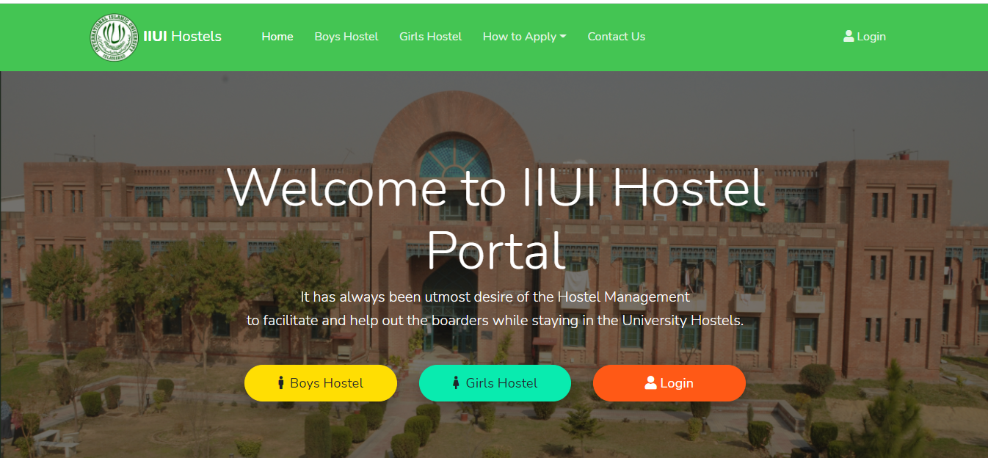
Literature Review
Market Survey
International Islamic University of Islamabad Hostels(IIUI Hostel)

Slide 8
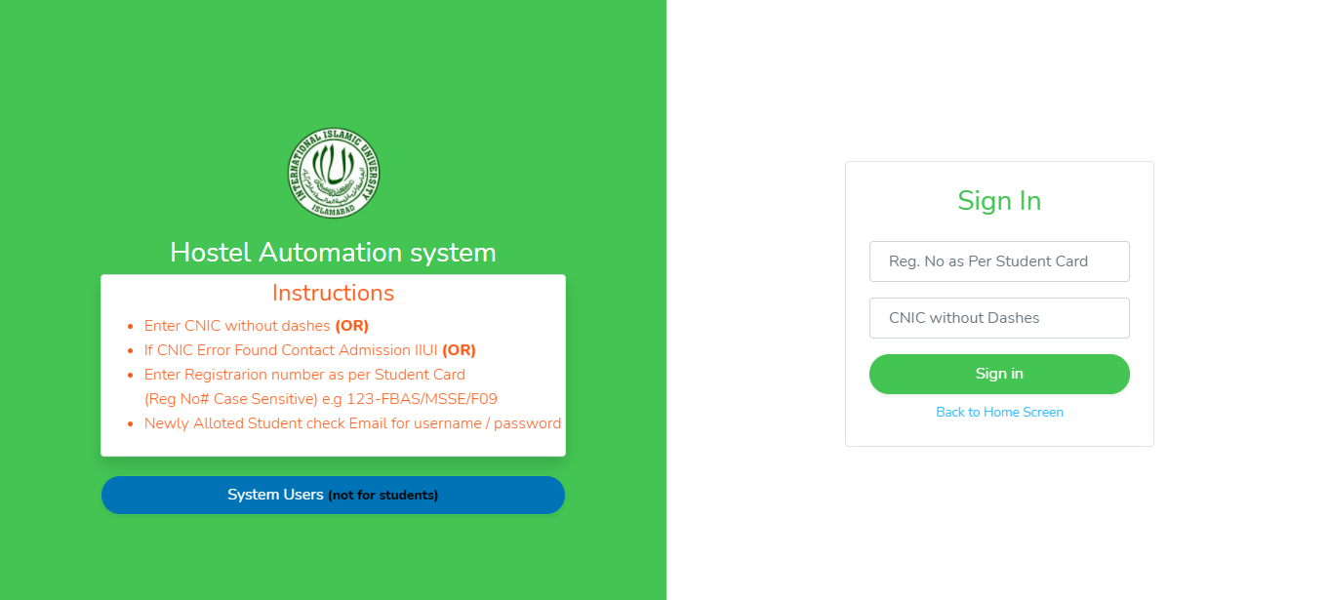
Literature Review
Market Survey
International Islamic University of Islamabad Hostels(IIUI Hostel)

Slide 9
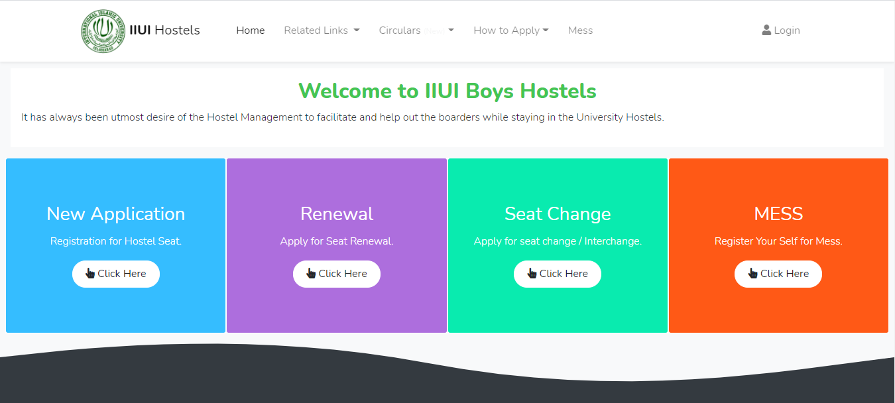
Literature Review
Market Survey
International Islamic University of Islamabad Hostels(IIUI Hostel)

Slide 10
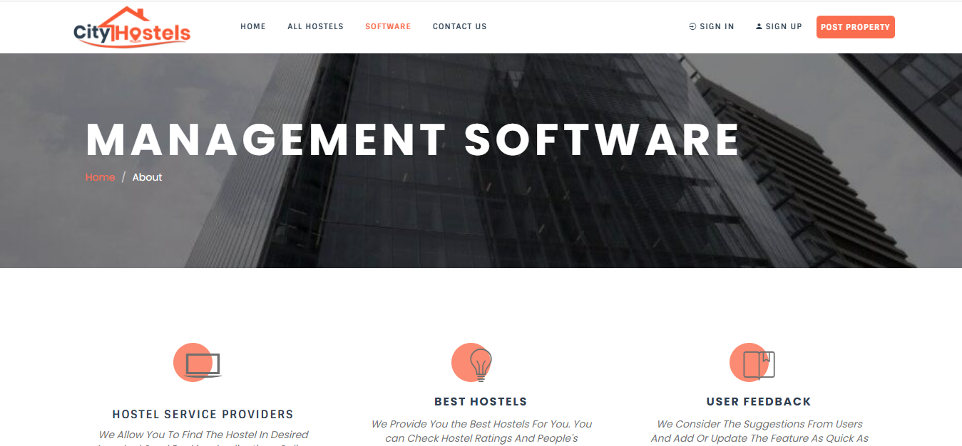
Literature Review
Market Survey
CityHostels

Slide 11
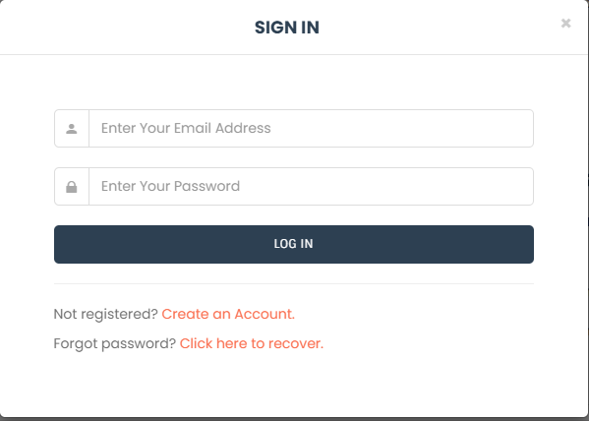
Literature Review
Market Survey
CityHostels

Slide 12
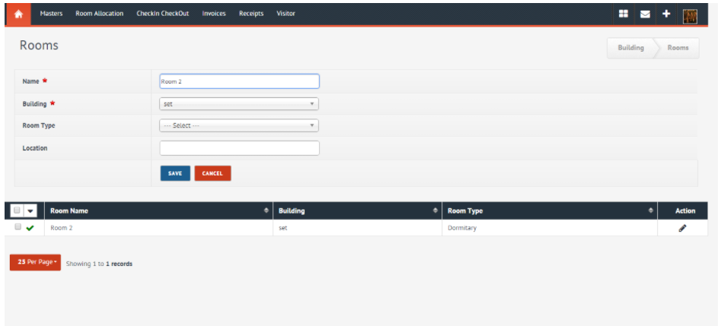
Literature Review
Market Survey
College Hostel Management Software by Initio

Slide 13
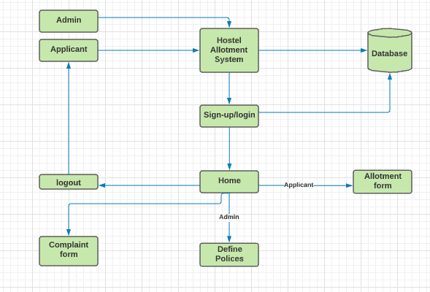
Proposed Methodology
Block Diagram
A block diagram is a system diagram in which the main elements or functions are represented by blocks that are connected by lines that illustrate the relationships between the blocks.

Slide 14
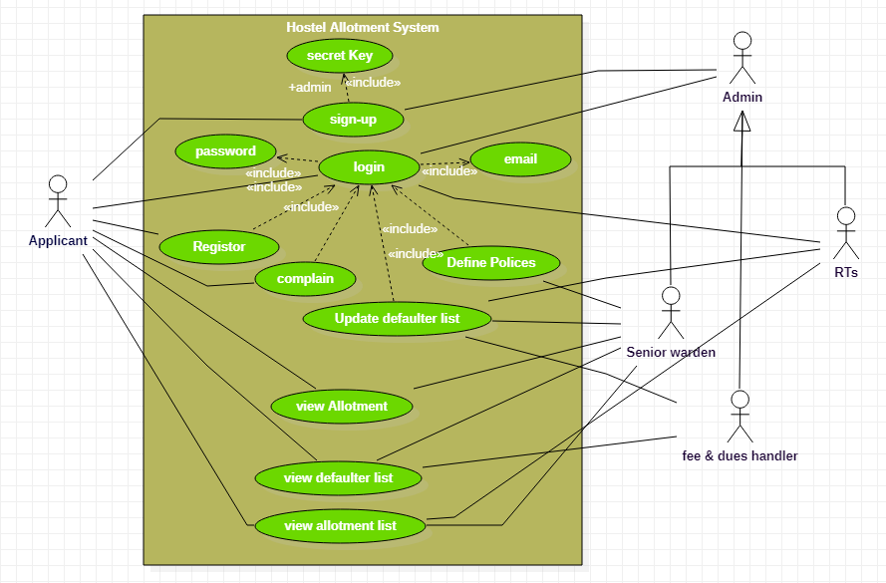
Proposed Methodology
Use case diagram
Use Case Diagram describes the system's functionality and requirements by using actors and use cases. Use Cases design the services, tasks, functions that a system needs to perform. Use cases showing high-level functionalities and how the user will handle them.

Slide 15
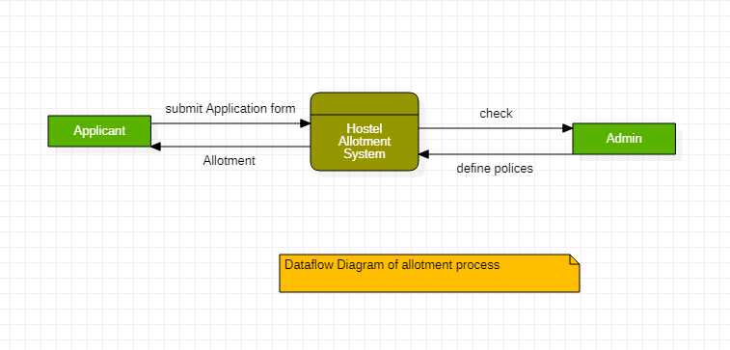
Proposed Methodology
Data Flow Diagram 0-level
Data Flow diagram (DFD) represents the visual look of the information flow in a system. It graphically represents the right amount of requirement of the system. There are three levels in a Data Flow Diagram 0-level, 1-level, and 2-level.
It is also called as a context diagram. It shows the abstract overview of the system both input and output data through arrows.

Slide 16
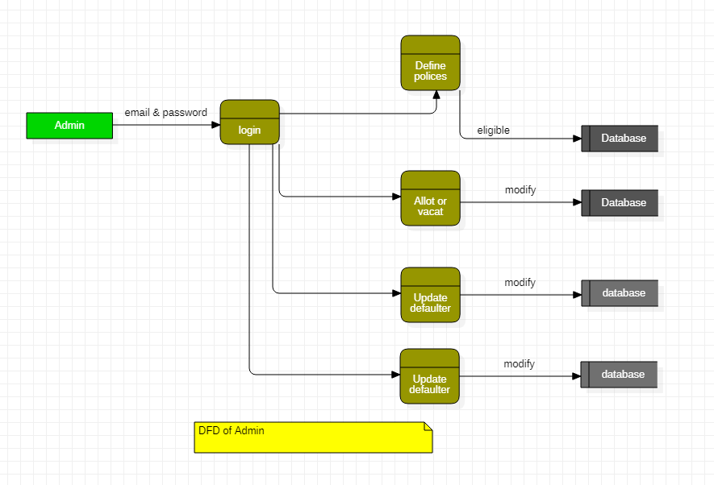
Proposed Methodology
Data Flow Diagram 1-level
Composed of multiple process, highlight the main functionalities of system and breakdown the 0-level process into subprocess.

Slide 17
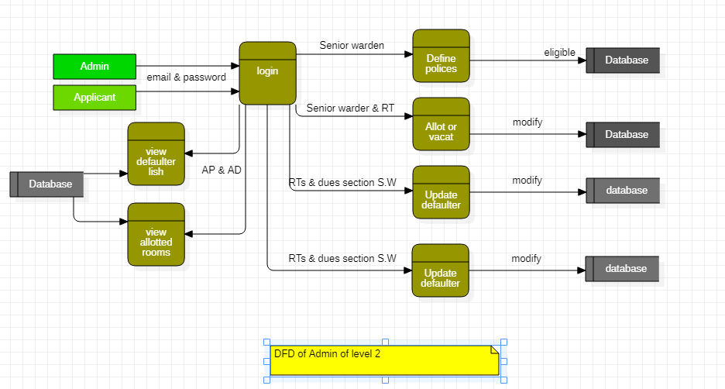
Proposed Methodology
Data Flow Diagram 2-level
It is one step deeper level of the 1-level. It represents the specific functionalities of the system.

Slide 18
Proposed Methodology
Development tools
We have developed a web application in which uses.
React.JS for frontend and,
Bootstrap and CSS for styling.
Node.JS for the backend.
MongoDB for Database management.
Our whole application is based on single computer in initial stages.

Slide 19
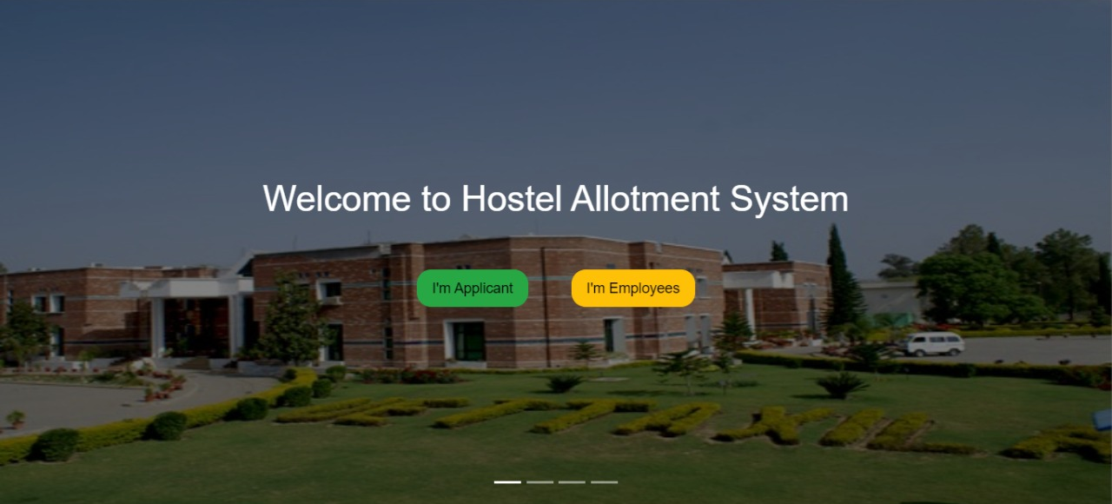
Results/Discussion
Main Page

Slide 20
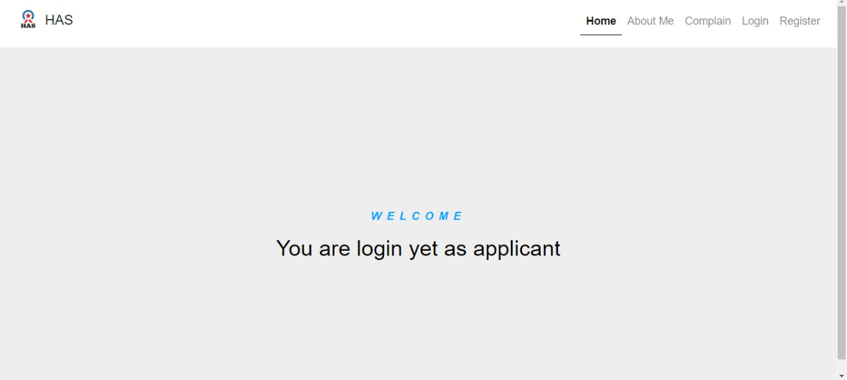
Results/Discussion
Dashboard page

Slide 21
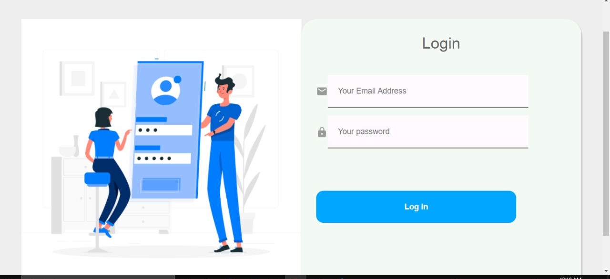
Results/Discussion
Login page

Slide 22
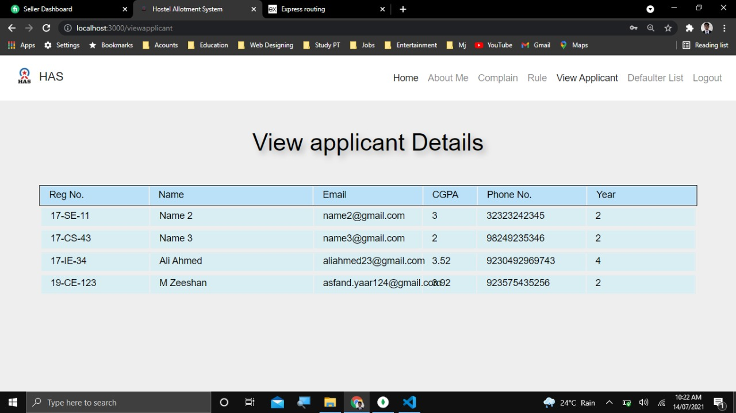
Results/Discussion
Applicant details page

Slide 23
Market Potential/Utilization
As our project is about the allotment of students so we can target schools, colleges, and universities by contacting them through email and informed them about our project that they can take benefits from our system by explaining all features of the Hostel Allotment system.
If we deployed the app to 10 organizations a year, each for 300,000 RS, then at the end of the year, gross sales will be:
300,000 x 10 = 3,000,000
Revenue
3000,000 – 1920000 = 1080000Rs

Slide 24
Conclusion
Hostel allotment system is a very useful web-based application this reduces the effort of the hostel managers to manage and keep the record easily and safely. This web-based application has a user-friendly interface with a rich GUI for easy to understand, easy to use. We will add more functionalities and make it more efficient and responsive to expand it to other universities and other private hostels in the future.

Slide 25
References
[1] E. A. B, "HOSTEL MANAGEMENT SYSTEM," June 2015. [Online]. Available: https://www.academia.edu/37040228/HOSTEL_MANAGEMENT_SYSTEM_full_project_1_.
[2] J. Walke, "React (JavaScript library)," 22 march 2021. [Online]. Available: http://en.wikipedia.org/wiki/React_(JavaScript_library).
[3] IIUI, 2021. [Online]. Available: http://usis.iiu.edu.pk:64453/
[4] 2017. [Online]. Available: https://www.cityhostels.com.pk/about/.
[5] R. Dahl, "Node.js," 23 June 2021. [Online]. Available: https://en.wikipedia.org/wiki/Node.js

Slide 26


